Slide 1
Implementing faster IP Lookup using Radix trees

Slide 2
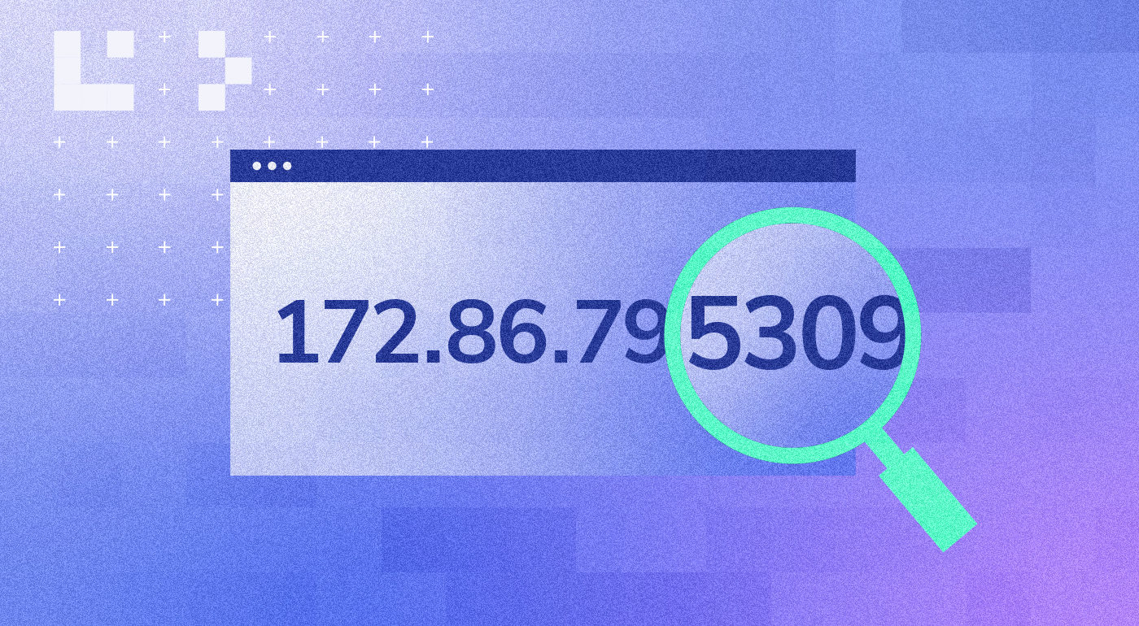
What is an IP address?

Slide 3

Why IP ?

Slide 4
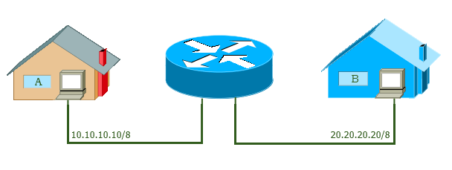
What’s a router?
Router

Slide 5
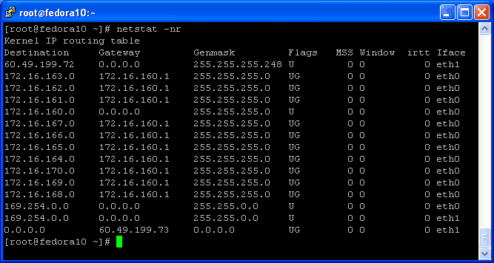
Routing table

Slide 6
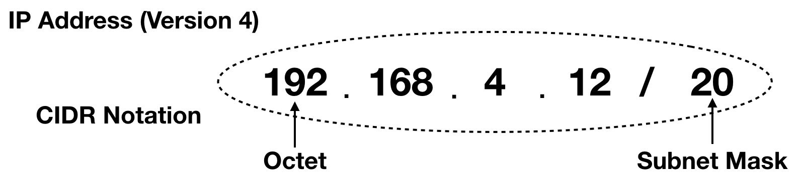
CIDR Classless Inter Domain Routing
IP range | No. of IPs | Mask Bits | Subnet Mask
192.168.0.0 - 192.168.15.255 | 4,096 | 20 | 255.255.240.0

Slide 7
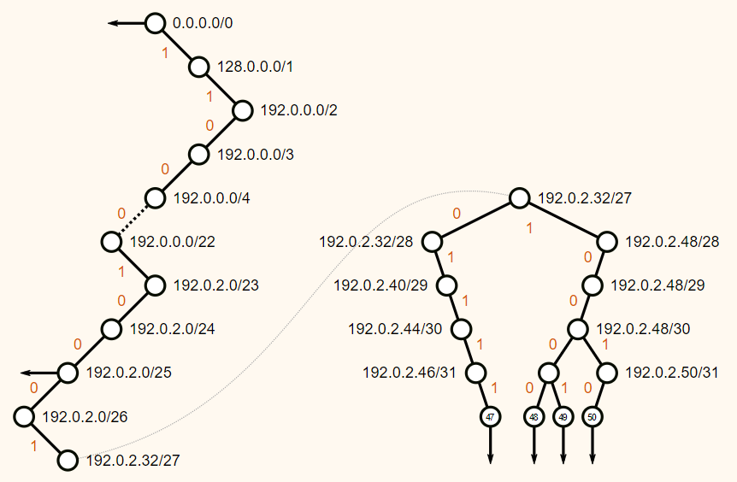
Using tries for IP lookup
Uses each bit of the address in sequential manner to determine which direction to go and thus stores the required data in time proportional to the length of the address
Considering only 32 bit IP addresses, for each address:
Insertion Time complexity : O(1)
Deletion Time complexity: O(1)
Searching Time complexity: O(1)
Space complexity: O(1)
1

Slide 8
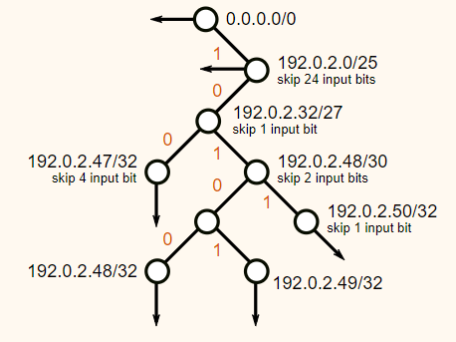
Using Radix trees for IP lookup
Uses sequence of bits of the address in a space eficient manner so that it does not need to go down 32 levels to store each address.
Considering only 32 bit IP addresses, for each address:
Insertion Time complexity : O(1) but faster than tries
Deletion Time complexity: O(1) but faster than tries
Searching Time complexity: O(1) but faster than tries
Space complexity: O(1) but better space efficiency than tries

Slide 9
Speed and space Comparison Trie vs Radix tree

Slide 10
The end
Next up: Code Demonstration of our implemetation

